Slide 1


Economics 101 (#3)
Economy of Scale

Slide 2
Outline
Definition
2. Short Run Average Cost (SRAC)
3. Long Run Average Cost (LRAC)
4. Internal Economies/Diseconomies of Scale
5. External Economies/Diseconomies of Scale
6. Summary/Overview

Slide 3
Economies of Scale
Factors which make it cheaper for larger companies to produce goods
than smaller ones
i.e. why do larger companies have cost advantages
over smaller companies

Slide 4
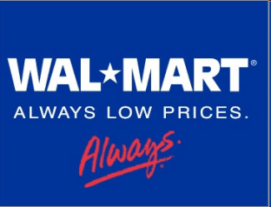
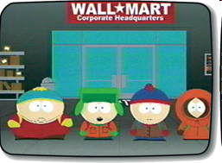


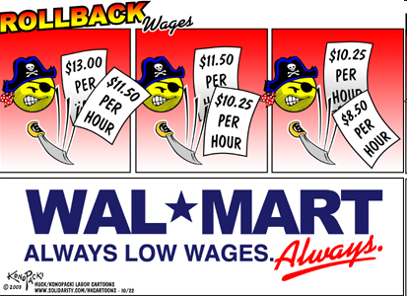
Since the 1980s, Wal*Mart Stores have appears in every community in America. Wal*Mart buys their goods in large quantities and therefore at cheaper prices. Wal*Mart locates its stores where land prices are low, usually outside of the community business district. Many customers shop at Wal*Mart because of low prices and free parking. Local retailers, like the neighbourhood drug store, often go out of business because they lose customers.
What does this story demonstrate?
Consumers are boycotting local retailers
Wal*Mart engages in illegal acts of monopolisation
There are diseconomies of scale in retail sales
There are economies of scale in retail sales
Wal*Mart is managed by ruthless business people

Slide 5
Definition
Where do economies of scale (EOS) occur in these diagrams?
Unit Cost
£
AC
.
.
AC
.
.
.
.
.
.
.
0
Output
0
Output

Slide 6
Definition
Where do economies of scale (EOS) occur in these diagrams?
Unit Cost
£
AC
.
.
AC
.
.
.
.
.
.
.
0
Output
0
Output
Economies
of Scale
Economies
of Scale
Economies of scale exist where average cost (AC) is declining

Slide 7
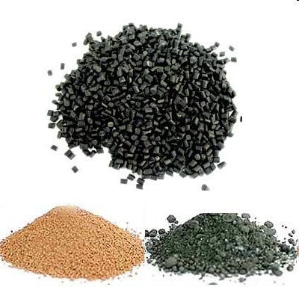
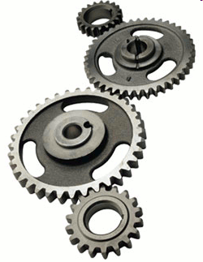
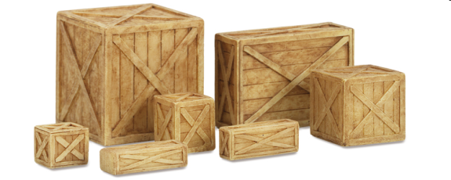
Definition
Economies
  Its all about costs! ‘Economies’ =
  Cost Advantages/Cost Savings
Scale
  The amount of investment in fixed
  factors of production
Benefits of a Larger Organisation
Indivisible Inputs & Input Specialisation
Productive Efficiency + Competitive Advantage
Lower Prices Higher Profits
Consumers/Society Win Company Wins
Raw Materials
Production
Output

Slide 8
Definition
Production Cost = FC + VC
C(q) = FC + VC
Rewrite as: C(q) = FC + cq [SR]
AC therefore = AC(q) = F/q + c
The reason AC drops therefore is an increasing F/q i.e. better spread of fixed costs (increasing value of q)
-NB-
Producing more and more pulls AC down to MC level (most efficient level)
The Cost Relationship
£
MC
AC
EOS: If AC > MC
or AC/MC < 1
DOS: If AC < MC
or AC/MC > 1
AFC
Output
Notes:
C(q) = FC + cq….AC(q) = c +F/q – Means that for Average Costs, variable costs will directly change as output increases (related to quantity) but fixed costs will be spread over a greater output and thus better use is made of fixed resources

Slide 9




Short Run Average Cost (SRAC)
Focus on increasing returns to scale
Firm grows =
easier to sell more
output and tap
benefits of large-
scale production.
For MS, overhead
costs are huge
[Cost of Sales
c$30bn in 2009]
Marginal Cost (MC)
close to zero!
Extra output
reduces AC, giving
the business the
scope to exploit
economies of scale
MS uses image, reputation,
feedback, consumer loyalty
etc to create demand
↑Demand ↑Price
= ↑Production
Same (essentially) Costs
– Greater Output = Lower
AC

Slide 10


Short Run Average Cost (SRAC)
Why is the AC curve initially downward sloping?
As output increases, the cost of producing a unit of a good falls
Raw Materials
Production
Output
X2
X3
SRAC
If AC is declining (negative slope) you have EOS
If AC is rising (positive slope), you have DOS
Declining Costs
F/q
LOW Output
HIGH Output
Increasing Output
x

Slide 11
Long Run Average Cost (LRAC)
Unit Cost
£
Economies of Scale
Diseconomies of Scale
.
LRAC
.
.
.
.
.
MES: Minimum Efficient Scale
Scale of production where internal EOS are fully exploited
.
.
.
.
0
Output
MES
Composed of an infinite number of company sizes/scales i.e. many possible levels of production (combinations of cost and output) that COULD be produced

Slide 12
Long Run Average Cost (LRAC)
Unit Cost
£
Economies of Scale
Diseconomies of Scale
.
Scale A
(SRAC ₁)
LRAC
£110
Scale B
(SRAC ₂)
.
.
£50
Scale C
(SRAC ₃)
.
.
Scale D
(SRAC ₄)
£30
£20
0
Output
50
100
150
200
MES
‘Technical Optimum’ @
Cost = £20, Quantity = 200
Notes:
MES- acts as a deterrent according to Bain – how large it is relative to industry output – MES was large enough to impede entry if a firm that entered with an MES plant would cause the price to fall and make its entry known to incumbents
The higher the MES- the less number of firms in the LR Oligopoly
Market concentration is expected to worsen as EOS increase (Internal)

Slide 13
Long Run Average Cost (LRAC)
Unit Cost
£
Economies of Scale
Diseconomies of Scale
.
Scale A
(SRAC ₁)
LRAC
Scale B
(SRAC ₂)
.
.
Scale C
(SRAC ₃)
.
.
Scale D
(SRAC ₄)
200
Output
@ Minimum
Point
NOT
@ Minimum
Point
MES

Slide 14
Long Run Average Cost (LRAC)
Unit Cost
£
Economies of Scale
Diseconomies of Scale
.
Scale A
(SRAC ₁)
LRAC
Scale B
(SRAC ₂)
.
.
Scale C
(SRAC ₃)
.
.
Scale D
(SRAC ₄)
0
Output
200
MES: Minimum Efficient Scale
Scale of production where internal EOS are fully exploited

Slide 15
Long Run Average Cost (LRAC)
Unit Cost
£
Economies of Scale
Diseconomies of Scale
.
LRAC
Cost per unit is dropping (Increasing
Efficiencies)
Cost per unit is rising (Decreasing
Efficiencies)
Curve is steep
Curve is steep
.
.
.
The Greater the Production (Output) the Lower the Unit Cost
.
Flatter curve
Flatter curve
MES
Output
So, how does a firm achieve efficiencies?

Slide 16
Internal Vs External Economies
An industry with 10 firms; each produces 100 discs.
Industry output is 1,000 discs. Now imagine....
(1) Industry doubles in size (20 firms) and produces at the same level (100
discs), Industry grows so each firm costs may fall; efficiency gains per
firm as a result of resources controlled externally to the firm →
Exhibits External EOS [Every firm benefits]
OR
(2) Industry output remains the same (1,000 discs). Numbers of firms in the
industry falls (to 5 firms) so that each of the remaining firms produce
200 discs. If costs of production remain the same, advantages to large
firms → Exhibits Internal EOS [Larger firms benefit]
Notes:
Market concentration grows – resulting in internal EOS due to the fact that industry output remains the same as before
If Industry EOS are purely external → no advantages to large firms – many small firms and be perfectly competitive
If Industry EOS are purely internal → large firms have a cost advantage over small – lead to an imperfectly competitive market structure

Slide 17
Internal Economies/Diseconomies of Scale
Economies
Technical
Buy/utilise better machinery/methods
Promotion of integrated production
Specialisation of labour
Learning by doing principles – ability to realise best production methods & technology
Managerial/Labour
Bargaining power with employees (Multiple TUs V. One TU)
Use new financial resources to outsource unnecessary elements
New mechanical process not manual – ‘human error’ removed
Commercial
Marketing - Spread of advertising impact over a wider output (especially where good homogenous) – Promotion also lifts demand, and thus price and profitability
Monopsony - Bulk buying @ discounted prices [Wal*Mart power]
Financial
Better access to credit
Larger = potential of quote on stock market = fresh/cheaper bonds
Risk Bearing
Firms reduce risk of falling demand, or going bankrupt by diversifying risk via product portfolio
Back up products + back up materials
Eg. Apple Mac, iPhones, printers, software, Leopard
Protect AC as production can shift into the higher demand product
Network
Perfect for mainly online companies eg eBay
The growth and success of eCommerce is mainly due to this EOS
Notes:
Internal EOS – within the firm
Wal*Mart movie – The High Cost of Low Price
Schumpeterian Hypo – desirable to organise production in large firms because such a system is conductive to tech advance

Slide 18
Internal Economies/Diseconomies of Scale
Diseconomies
Technical
Repetition – as a result of specialisation ↑Employees– management span on control becomes unwieldy
Duplication
Monitoring costs (time)
Managerial/Labour
Communication- Greater layers of management
Issue of non-productive workers
Issue of insuring against fidelity
Conflict/Absenteeism/Morale– ‘merely cogs in the production machine.’
Financial
Overreliance on cheap credit for expansion or avoiding regulation i.e. Anglo Irish Bank , Northern Rock
Risk of bad debts

Slide 19
External Economies/Diseconomies of Scale
Economies
Infrastructure
Better transport network
Airports, ports, motorways, local roads
Cheaper/more direct access to raw materials
R&D Facilities
Local universities
Component Economies
Relocation of component suppliers
Relocation of support business
Growth of ‘industrial parks/estates’
Ex. Shannon Free Zone, Canary Wharf, Silicon Valley
Diseconomies
Infrastructure
Overuse damage, congestion
Labour
Demand for skilled labour explodes – skill set in short supply – hiring of less qualified
Overexploitation
Raw materials demand rises – price rises
Usage of lower quality materials
Notes:
External EOS- outside the firm but within the industry [Common to all firms in the industry]

Slide 20
Labour Specialisation
Better Equipment
Learning By Doing
Technical
Infrastructure
Marketing/Monopsony
Network
Local knowledge
and Skills
ECONOMIES
Buying Power/Selling
/Advertising
I
N
T
E
R
N
A
L
E
X
T
E
R
N
A
L
ECONOMIES
R&D
Cheaper Credit
Financial
Better Credit Access
ECONOMIES OF
SCALE
Reputation
Outsourcing
Bargaining Power
Managerial
Diversification
Risk Bearing
Infrastructure
Damage/
Congestion
Repetition/Duplication
Conflict/Absenteeism/
Morale
Overexploitation
DISECONOMIES
DISECONOMIES
Raw Materials
Demand/Lower
Quality
Fidelity Issues
Constraints on Labour Supply
Risk of Bad Debts/Cheap Credit
Lower Quality
Workforce
EXTERNAL TO FIRM
(WITHIN INDUSTRY)
INTERNAL TO THE FIRM

Slide 21
Overview
Definition: Factors which make it cheaper for larger companies to produce goods than smaller ones
Cost Relationship
Cost advantages exploited by expanding production
EOS represent a movement along the LRAC Curve
‘Learning by Doing’ represent a shift in the LRAC Curve
Pre-MES (technical optimum), firms do not operate at the lowest point on AC curve
Minimum Efficient Scale (MES) = Scale of production where internal EOS are fully exploited
Importance of EOS in Macro? Countries trade to achieve EOS
EOS are exhibited both Internally (within the firm) and Externally (outside the firm, impacting the overall industry)
EOS: If AC > MC or AC/MC < 1
DOS: If AC < MC or AC/MC > 1
C(q) = FC + cq
AC therefore AC(q) = F/q + c
Economies of scale exist where average cost (AC) is declining

